Slide 1
Lecture 2-3
BT 203
Biochemistry
3-0-0-6
Prof. Ajaikumar B. Kunnumakkara
CANCER BIOLOGY LABORATORY
Department of Biosciences and Bioengineering
Indian Institute of Technology (IIT) Guwahati
Assam, INDIA

Slide 2
Key Concepts
What are Lipids?
What are the different types of lipids?
What are fatty acids?
What are the different types of fatty acids?
What are diseases associated with glycoconjugates?

Slide 3
LIPIDS
General Information
A lipid is an organic substance found in living systems that is insoluble in water but is soluble in organic solvents
May contain phosphoric acid, nitrogenous base and carbohydrates
Lipids vary widely in their structures. They have mostly carbon, hydrogen and some have a few polar atoms/ functional groups
Bloor’s Criteria
Insoluble in water and soluble in organic solvents such as chloroform, benzene, acetone
Esters of fatty acids
Possibility of utilization by living organisms
Biomedical Importance
Important dietary constituents and acts as a fuel
Can be stored in the body-in almost unlimited amount
Insulation
Building materials
Essential for neurons and membranes

Slide 4
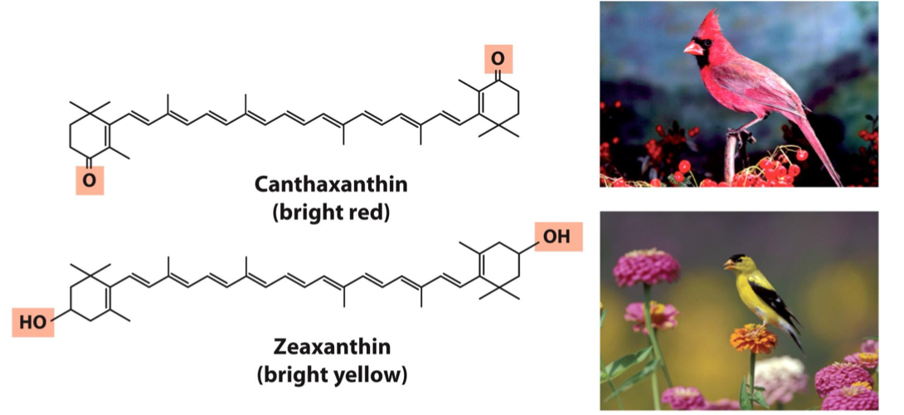
LIPIDS AS PIGMENTS

Slide 5
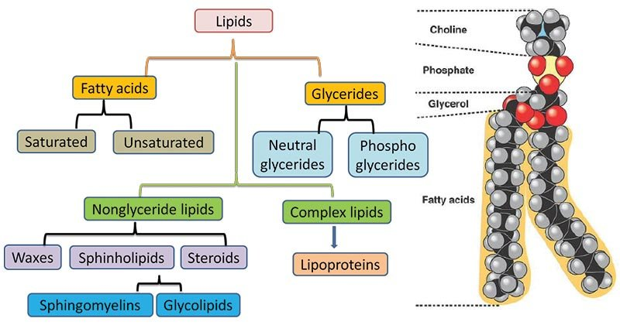
LIPIDS- CLASSIFICATION
Classification of lipids
Simple Lipids –Esters of fatty acids with various alcohols
Neutral fats- tri-esters of fatty acids and glycerol
Waxes-mono-hydroxy aliphatic alcohols; Vitamin A and D are palmitic or stearic acids esters
Compound Lipids- Esters of fatty acids
Phospholipids
Glycolipids
Sulpholipids
Aminolipids
Lipoproteins
Derived Lipids
Fatty acids
Mono- and di-acylglycerides
Alcohols

Slide 6
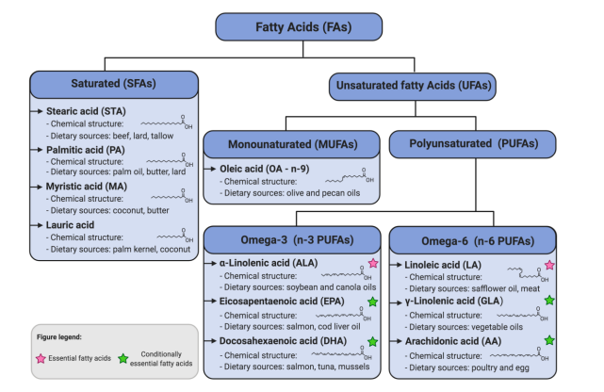
Derived Lipids
Fatty Acids (FA)
Organic acid found in triglycerides
Obtained from the hydrolysis of fats
Mono-carboxylic acid ranging in chain length from C4 to C24 carbon atoms
Amphipathic molecule
Types of FA
Odd chain
Even chain
Depending on Number of carbon atoms –
Depending on length of hydrocarbon chains-
Depending on nature of hydrocarbon chain-
Short chain
Medium chain
Long chain
Very long chain
Saturated
Unsaturated
Branched
Hydroxy
Almost all natural unsaturated fatty acids have cis stereochemistry in C=C’s.
Small amounts of trans are produced in stomachs of ruminating animals by partial enzymatic hydrogenation of polyunsaturated fats, and thus are present in small amounts in milk and butter

Slide 7
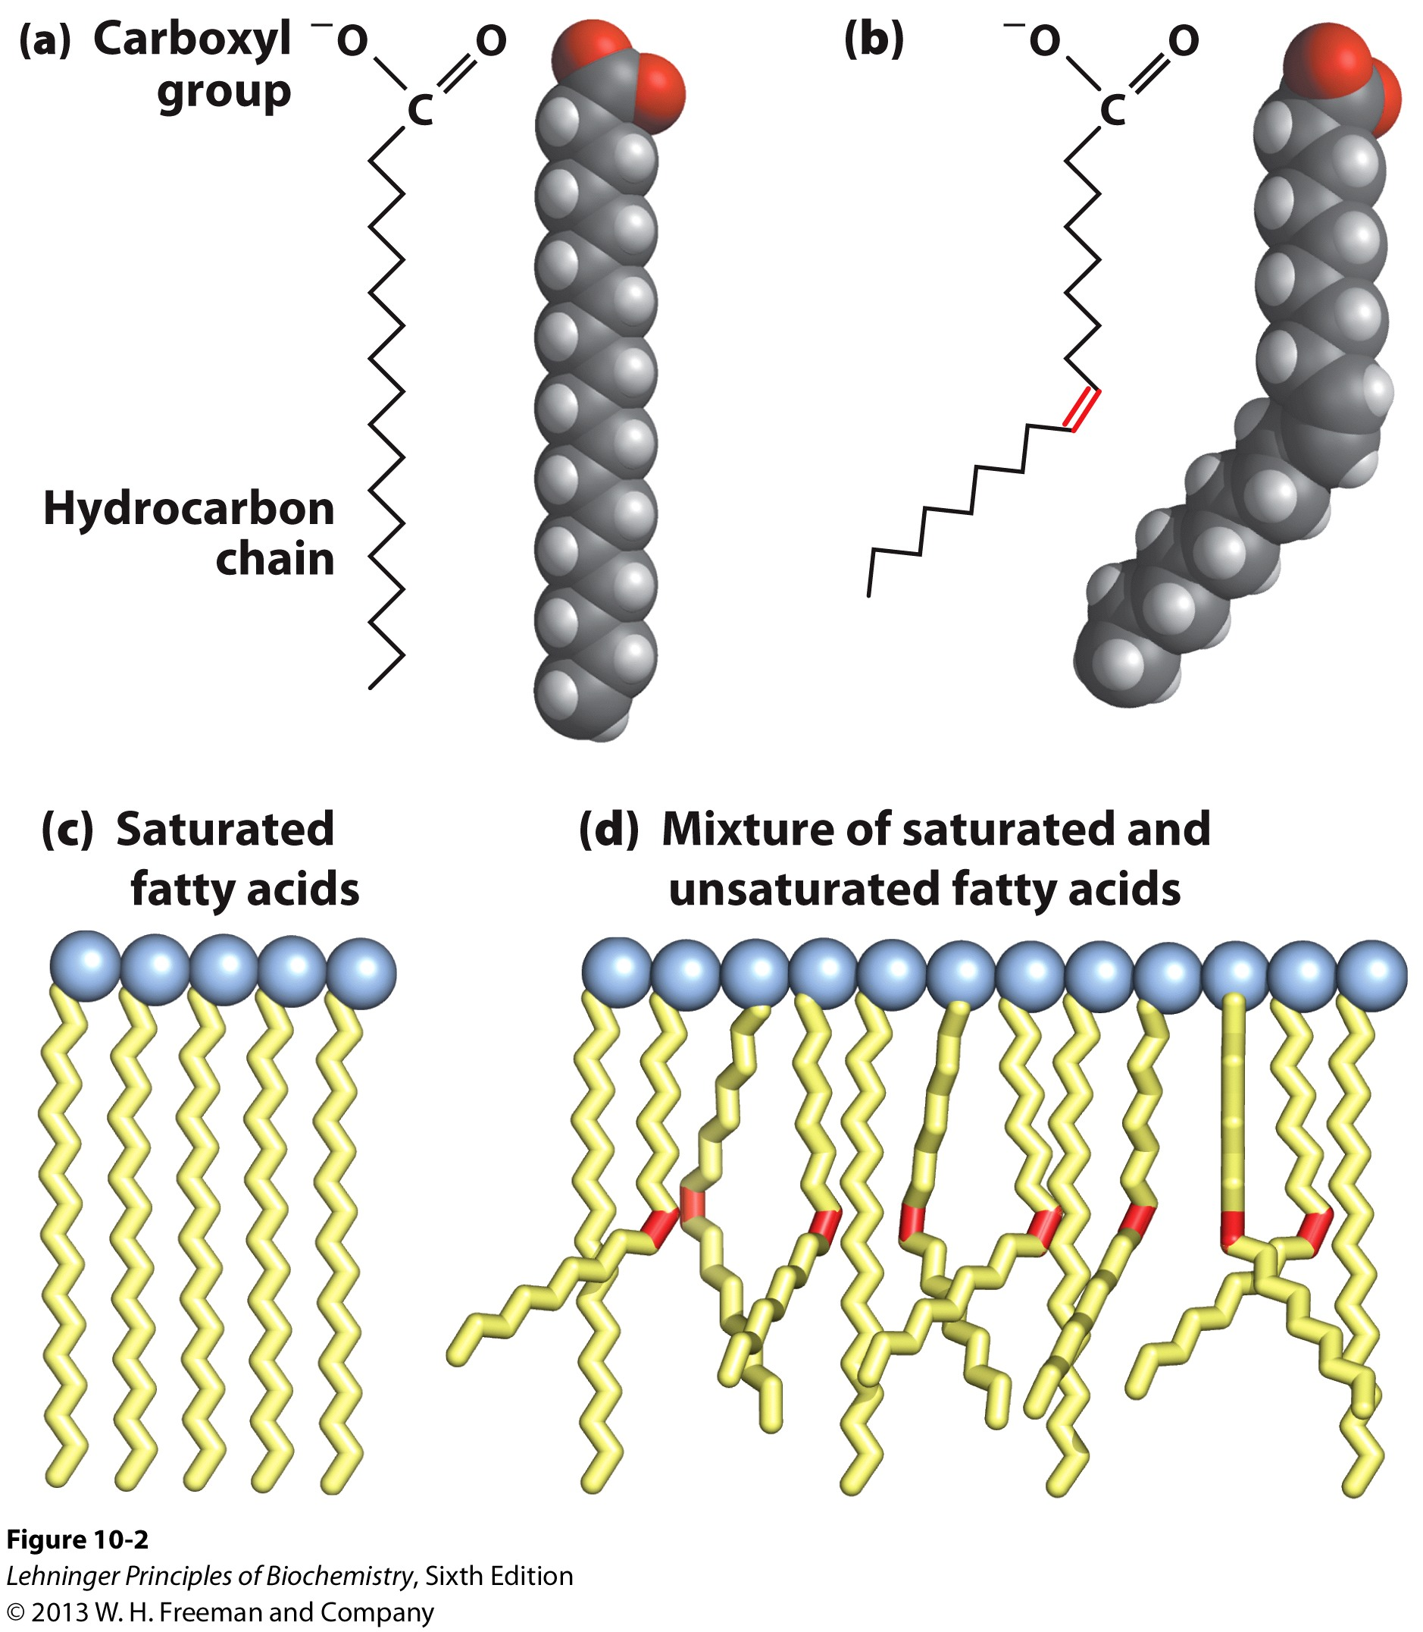
Properties of fatty acids
Saturated fatty acids pack tightly and form more rigid, organized aggregates
Unsaturated chains bend and pack in a less ordered way, with greater potential for motion
Membrane fluidity determined by temperature and the degree of fatty acid unsaturation of phospholipids
Certain bacteria can modulate fatty acid unsaturation in response to temperature

Slide 8
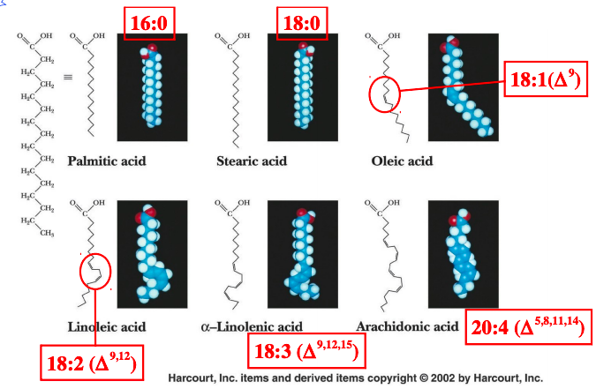
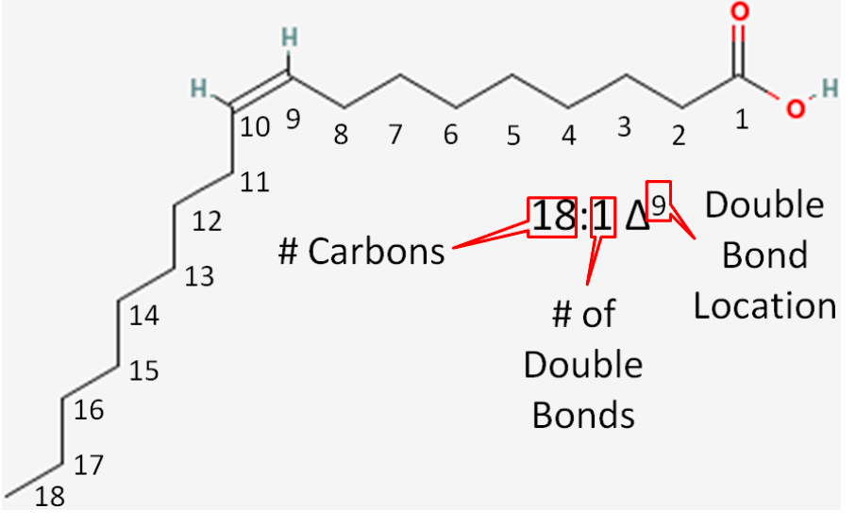
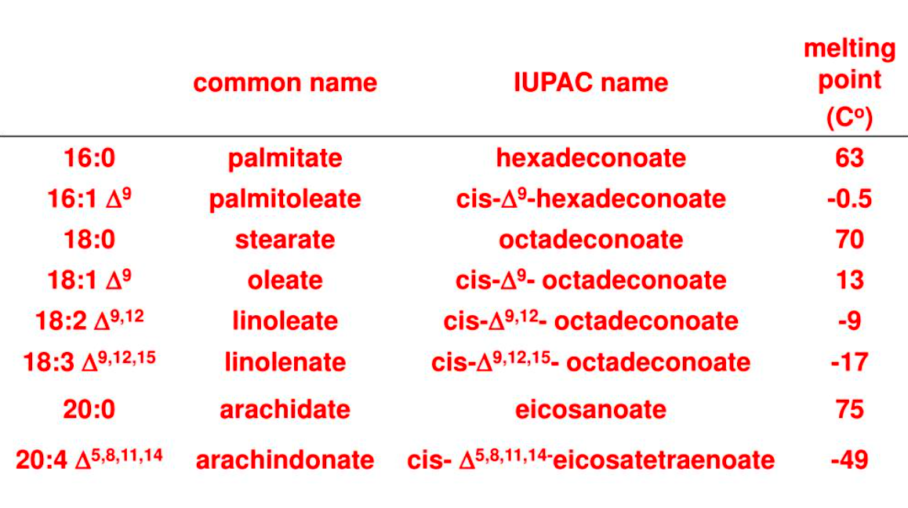
Nomenclature of fatty acids
Number of carbon atoms
“Oic” being the substitute
Saturated fatty acids end in “anoic” e.g. octanoic acid
Unsaturated fatty acids end in “enoic” e.g. octadecenoic acid
Number of carbon atoms | 18
Number of double bonds | 1
Number of carbons from the carboxylic acid end to the first double bond | 9
Name: 18:9() cis-9-octadecenoic acid

Slide 9
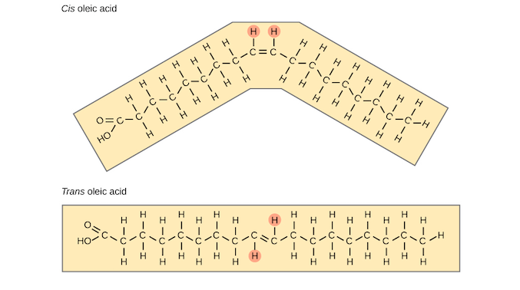
Configuration of Unsaturated fatty acids
Unsaturated fatty acids contain double bonds
Exists in either cis- or trans- configuration
Cis-configuration: The two hydrogen atoms associated with the double bond are present on the same side causing the kink
Trans-configuration: The two hydrogen atoms associated with the double bond are present on the different side

Slide 10
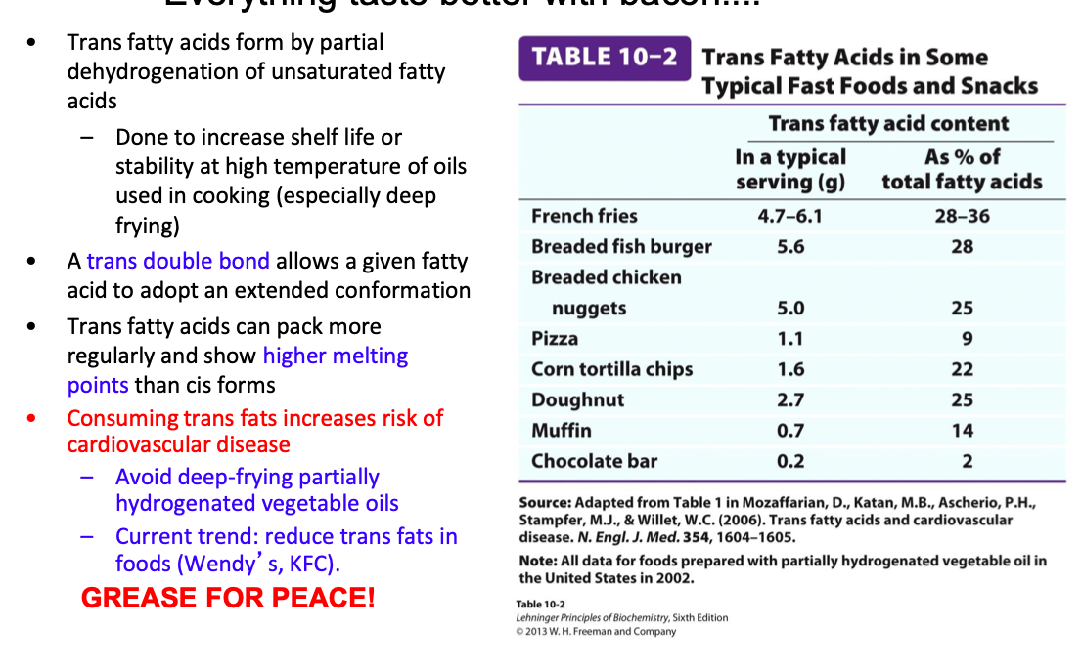
Food is tasty???

Slide 11
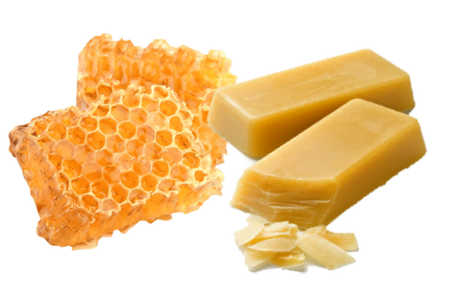
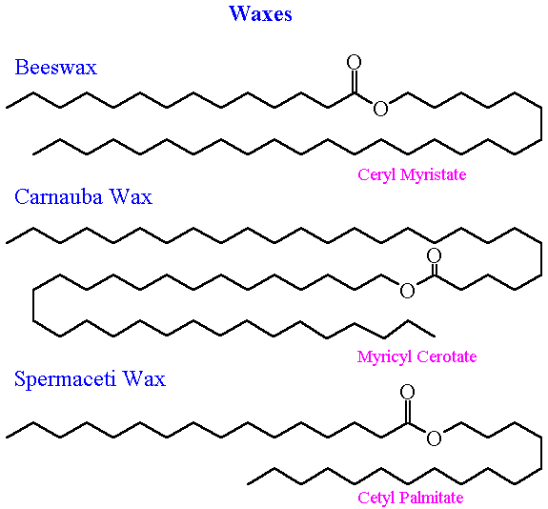
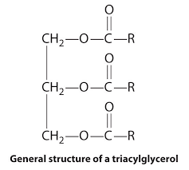
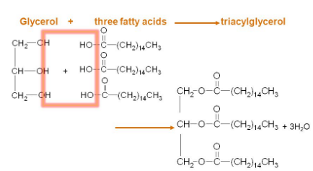
Simple Lipids
Simple lipids are esters of fatty acids with alcohol
Fats and oils: esters of fatty acid with glycerol
Waxes : esters of fatty acids with high molecular weight monohydric alcohol

Slide 12
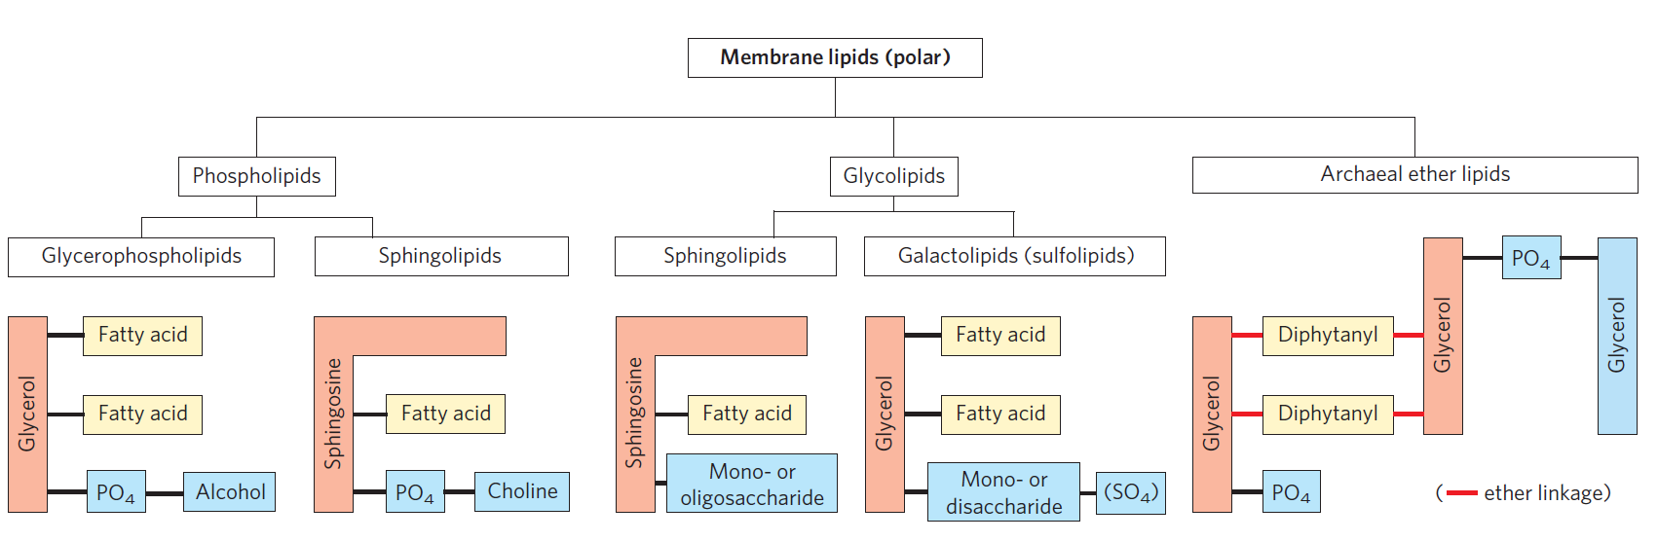
Compounds Lipids (Membrane Lipids)

Slide 13
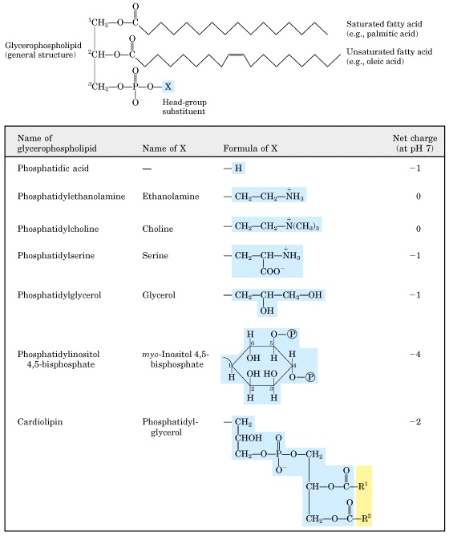
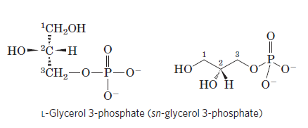
Glycerophospholipids
Phosphatidic acid derivatives
Structure- Two fatty acids are attached in ester linkage to the first and second carbons of glycerol, and a highly polar or charged group is attached through a phosphodiester linkage to the third carbon
Diacylglycerols linked to a polar alcohol by a phosphodiester bond
The fatty acids vary within each group, but usually are sat’d C16/18 at C1, and unsat’d C18/20 at C2
Note: the charge on the alcohol may be positive, negative, or neutral

Slide 14
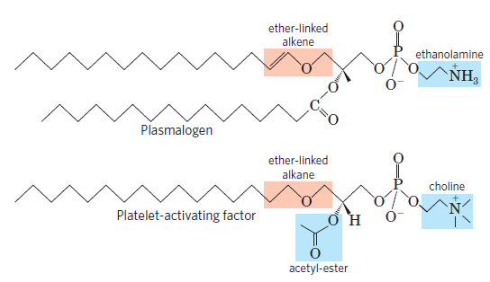
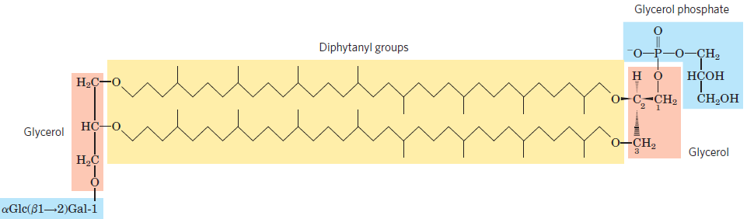
Unique Glycerophospholipids
Ether Glycerophospholipids
Archaea Membranes
Archaea live in ecological niches with extreme conditions
Membrane lipids containing long-chain (32 carbons) branched hydrocarbons linked at each end to glycerol
Linkages are through ether bonds, which are much more stable to hydrolysis at low pH and high temperature
Glycerol dialkyl glycerol tetraethers (GDGTs)
One of the two acyl chains is attached to glycerol in ether
Plasmalogens- Heart lipids (double bond between C-1 and C-2 linkage )
Platelet activating factor

Slide 15
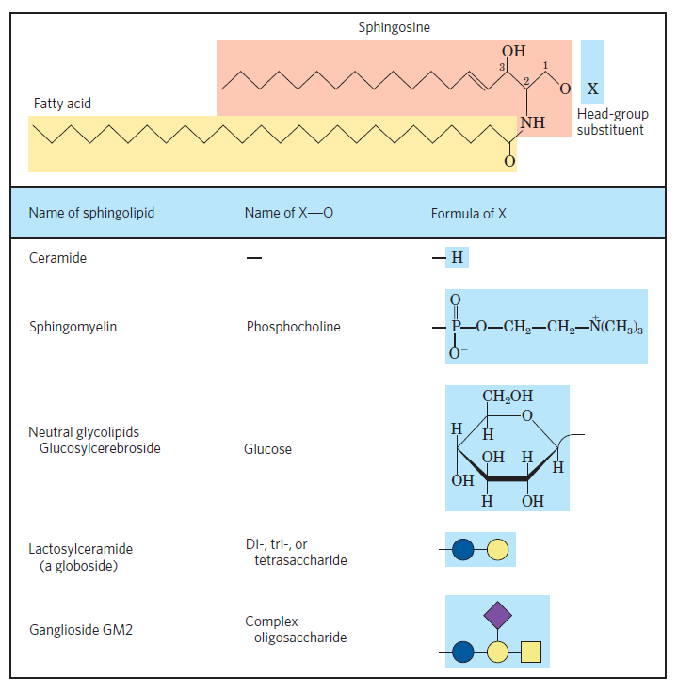
Sphingolipids
Derivatives of long-chain amino alcohol sphingosine
Ceramide (headgroup = H) is the parent of all sphingolipids
Sphingomyelins - polar headgroup (phospholipids)
phosphocholine
phosphoethanolamine
Glycosphingolipids – sugars, no phosphate (Neutral)
cerebrosides (1 sugar + ceramide)
globosides (2 sugars or more + ceramide)
Gangliosides- oligosaccharide headgroups (Charged)
with one or more sialic acid residues

Slide 16
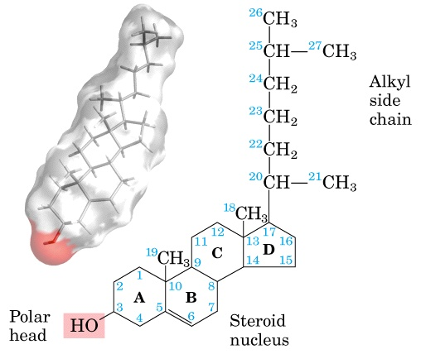
Sterols: Structural Lipids, Hormone Precursors, and Detergents
Structural lipids present in the membranes of most eukaryotic cells
Structure- Steroid nucleus, consisting of four fused rings, three with six carbons and one with five.
Cholesterol
The most fundamental and famous steroid is cholesterol
Have a structural role in most eukaryotic membranes
Hormone derivatives regulate gene expression
Sterols in other species: stigmasterol in plants and ergosterol in fungi

Slide 17
Important steroids in body
Androgens These are “male sex hormones” that regulate the development of the male reproductive system and the secondary sexual characteristics in males.
Progesterone, estrone, and estradiol These are “female sex hormones” that regulate the development of the female reproductive system and are responsible for the maintenance of secondary sexual characteristics in females.
Aldosterone This steroid controls water and electrolyte balances.
Cortisone This compound is involved in metabolism and in controlling inflammation.
Bile salts Facilitates the digestion of certain lipids and the absorption of fat-soluble vitamins.
Vitamin D An important steroid that controls calcium absorption and deposition in the bone. Recent research also suggests that vitamin D plays a fundamental role in the prevention of many cancers. High consumption of vitamin D and sun exposure appear to reduce cancer risk.

Slide 18
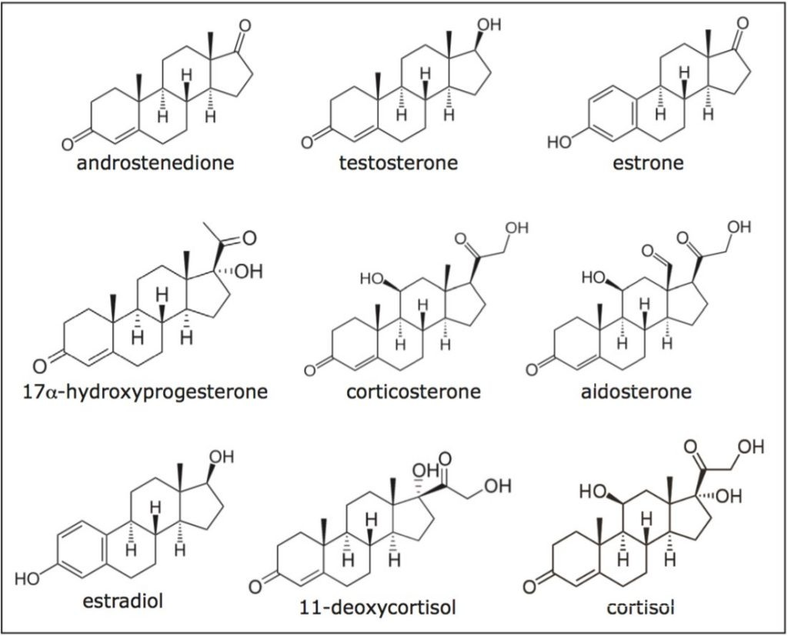
Important steroids in body

Slide 19
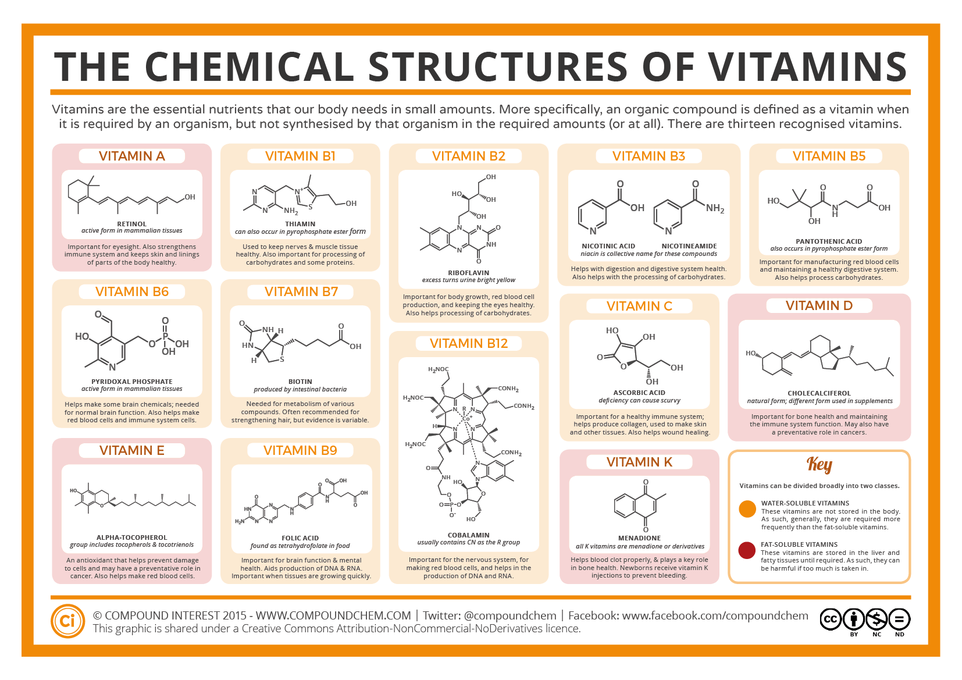
VITAMINS

Slide 20
Summary
Lipids- water insoluble compounds, storage and membrane lipids
Fatty acids and their classifications
Relevance of fatty acids in biological systems
Membrane proteins and their classifications
Glycerophospholipids
Sphingolipids
Sterols- Cholesterol and its analogues
Biological relevance of different steroids present in human body
Vitamins and its significance

